Slide 1
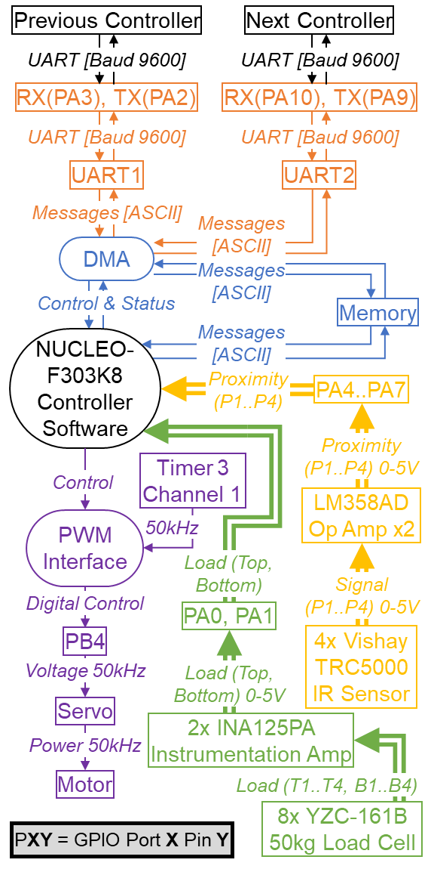
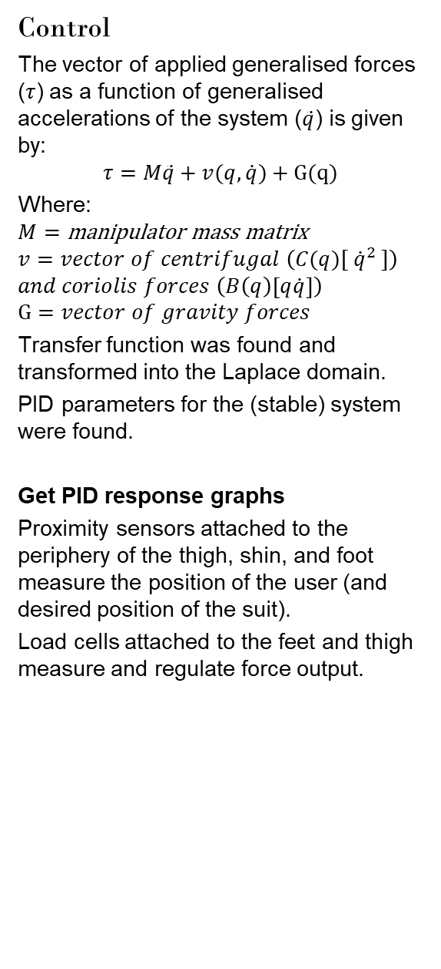
I AM FERROUS MAN
Samuel Williams & Dr Paul Pounds
Goals
Proof of concept for a novel powered exoskeleton control system.
Powered Exoskeleton
A wearable mobile machine controlled by a pilot to amplify their strength and reduce the exertion required to complete physical tasks.
Scope
Creation of a lower extremity exoskeleton suit to demonstrate functionality in a finite set of specific movements.
Scope limited to perception and control systems, excluding structural and actuation systems (handled by others).
Premise
Conventional exoskeletons use force based sensing to perceive the pilot’s desired position. Force based methods are often unstable and physically taxing.
Control can be accomplished by maintaining a constant offset from the pilot by sensing proximity and position.
Proof of concept requires:
Stability while static (standing)
Movement (walking)
Regulated force application (sitting)
Accomplished by controlling the:
position of the pilot and the suit;
force applied by the pilot; and,
force applied by the suit kt.
Control
The vector of applied generalised forces ($τ$) as a function of generalised accelerations of the system ($\ddot{q}$) is given by:
$$τ=M\ddot{q}+v(q,\dot{q})+G(q)$$
Where:
$$M=\text{manipulator} \text{mass} \text{matrix}$$
$$v=vector of centrifugal \left(C(q)[ {\dot{q}}^{2} ]\right)$$
$$and coriolis forces \left(B\left(q\right)\left[q\dot{q}\right]\right)$$
$$G=vector of gravity forces$$
Transfer function was found and transformed into the Laplace domain.
PID parameters for the (stable) system were found.
Get PID response graphs
Proximity sensors attached to the periphery of the thigh, shin, and foot measure the position of the user (and desired position of the suit).
Load cells attached to the feet and thigh measure and regulate force output.
Signal/Data Flow Diagram
Motor interface extends original scope.
Project Achievements
Proximity Sensors: TRCT5000 IR Transceiver selected and implemented. Firmware written, tested, and commissioned. Signal amplified by LM358AD Op Amp before being read by 12-Bit ADC of NUCLEO-F303K8.
Position of pilot relative to the suit, and control error (angle) measurable.
Force Sensors: Load Cells (YZC-161B 50kg) in Wheatstone bridge configuration amplified by INA125PA Instrumentation Amplified calibrated and commissioned.
Force applied by pilot to the suit and force applied but the suit to the environment measurable.
Control: Control variables and parameters (PIDF) found for all three
Communications:
System:

